Slide 1
Publishing Preparations
WP2 T3

Slide 2



Learning Objectives
Recognize accompanying files required in the Git repository
Describe relevant software tools for creating and validating accompanying files
Develop accompanying files for repositories hosting FAIR-by-Design learning materials

Slide 3
Agenda
File Descriptions
Editing Instructions
Committing Changes

Slide 4
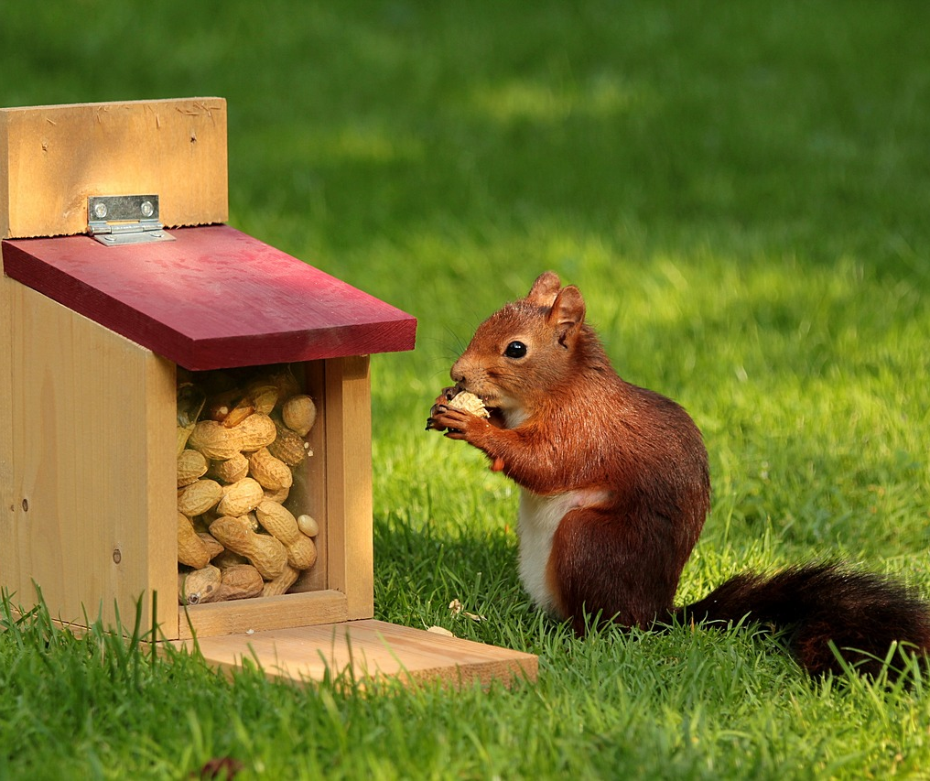
Accompanying Files in a Nutshell
Files which are present in the Git repository
Can either be free text or follow a strict schema
README.md vs. CITATION.cff
Readable by either humans or machines (or both!)
Contain metadata information
Special presentation on GitHub
Image by Christiane from Pixabay

Slide 5
Hello, my name is…
CITATION.cff
Citation information
Machine readable, controlled vocabularies
Renders citation information on GitHub
README.md
Free text
Description of the repository, shown on the homepage
CODE_OF_CONDUCT.md
Standard for community engagement
Conflict resolution guidelines
Rendered on GitHub

Slide 6

Last Minute Preparations
Latest changes pulled from GitHub
The Obsidian workspace is ready
Templates for all three files (CITATION.cff, README.md, CODE_OF_CONDUCT.md) already present in the repository
Image by e_stamm from Pixabay

Slide 7
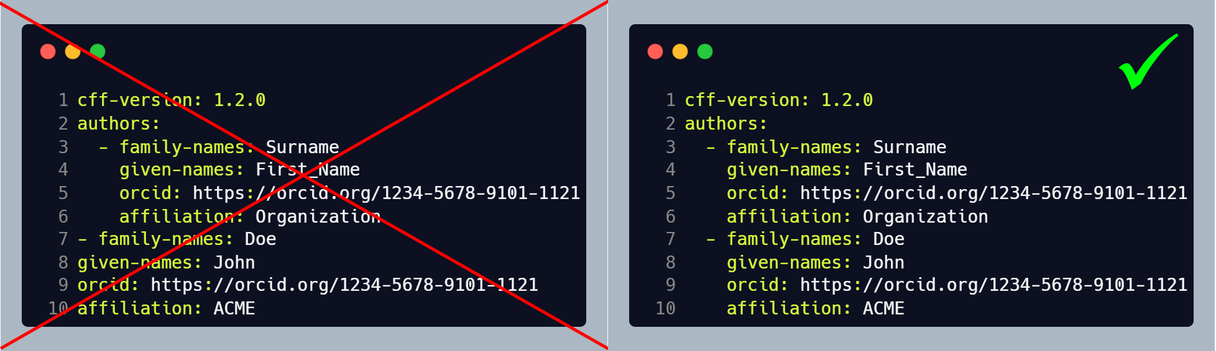
CITATION.cff
Prompt for opening in an external editor
YAML format
Consistent indentation is of utmost importance

Slide 8
CITATION.cff – Fields
authors
list of authors
title
title of the training
abstract
short abstract describing the learning materials
license (!)
license under which the material is made available
license-url (!)
a URL pointing to the license set in the License field
keywords
a list of keywords describing the training
repository
URL to the GitHub repository hosting the materials

Slide 9
CITATION.cff – Checking Validity
Other fields in the CITATION.cff should not be edited manually
Handled by the automatic publishing workflow
More details in the next presentation
Tool to verify the controlled vocabularies and overall syntax
https://citation-file-format.github.io/cff-initializer-javascript/#/update

Slide 10
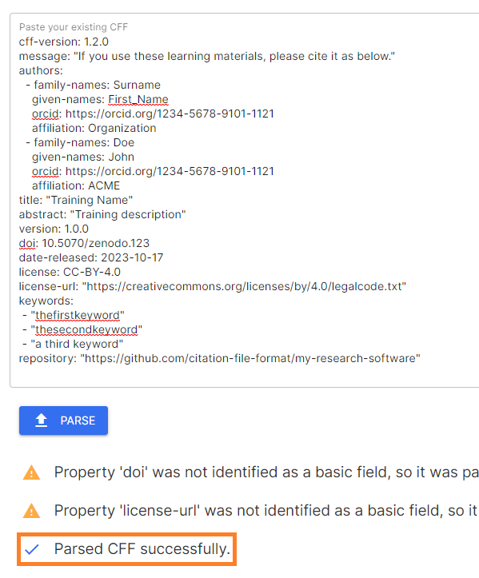
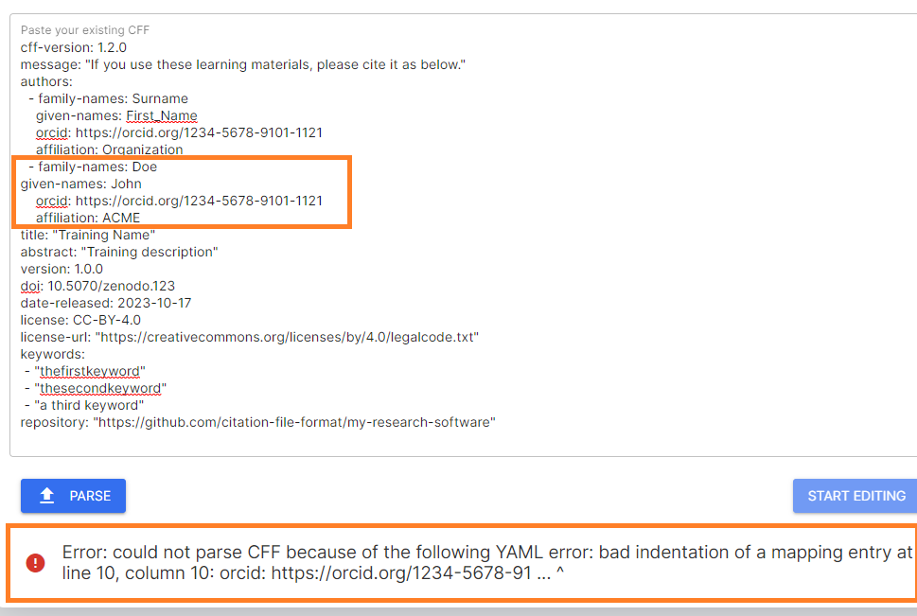
CITATION.cff – Validation Example
✅
❌

Slide 11

README.md
Standard Markdown, editable with Obsidian
Free text, without strict structure requirements
Ensure presence of:
Skills4EOSC header image
Optional reference to the template repository

Slide 12
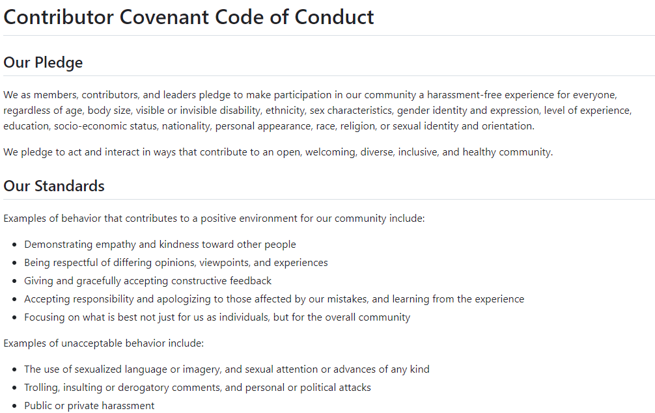
CODE_OF_CONDUCT.md
Generic text
Templates available online
The FAIR-by-Design templates repository also includes one
In most cases a single change is required: contact email

Slide 13
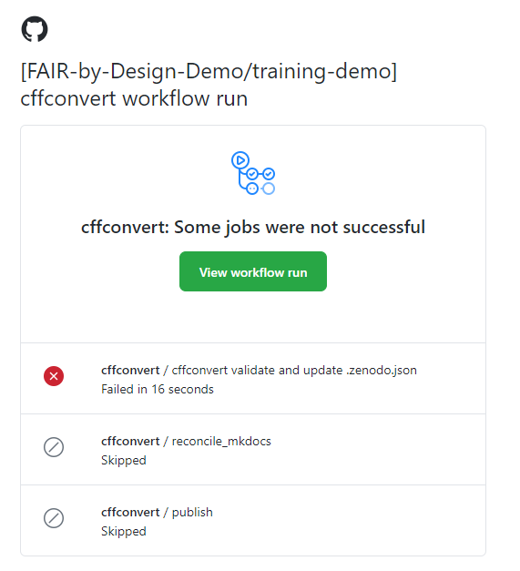
Committing Changes
Any changes to CITATION.cff start an automated workflow
Validate syntax and controlled vocabularies
Publish updated information in the Git book
Validation errors interrupt the workflow, and a notification email is sent to the owner of the repository

Slide 14
Publishing Preparation in Practice
Fill out the CITATION.cff, README.md, and CODE_OF_CONDUCT.md files in your forked repositories according to the instructions. Commit the changes and validate them by visiting your Git book website.

Slide 15
Thank you! Any questions before we continue?
vojdan.kjorveziroski@finki.ukim.mk
Cite instructions on: https://doi.org/10.5281/zenodo.10716172

